Slide 1



















Tahaluf Copyright 2022- All Right Reserved
Harmony IT Solution
learning Hub
Web Application Programming Interface (API)
Tahaluf Training Center 2022

Slide 2









Tahaluf Copyright 2022- All Right Reserved
Harmony IT Solution
1
Authentication VS Authorization
2
JSON Web Token (JWT)
3
Create LOGIN using JWT Token
4
5
4
7
6
8
8
9

Slide 3










Tahaluf Copyright 2022- All Right Reserved
Harmony IT Solution
Authentication
VS
Authorization

Slide 4
Tahaluf Copyright 2022- All Right Reserved
Harmony IT Solution
Authentication VS Authorization
Authentication verifies the user before allowing them access, and authorization determines what they can do once the system has granted them access .

Slide 5
Tahaluf Copyright 2022- All Right Reserved
Harmony IT Solution
Verifying that someone or anything is who they claim they are is done through the authentication procedure. To secure access to a program or its data, technology systems normally require some type of authentication. For example, you often need to enter your login and password in order to access a website or service online. Then, in the background, it checks your entered login and password to a record in its database. The system decides you are a valid user and provides you access if the data you provided matches.

Slide 6
Tahaluf Copyright 2022- All Right Reserved
Harmony IT Solution
The security procedure known as authorization establishes a user's or service's level of access. In technology, authorisation is used to provide users or services permission to access certain data or perform specific tasks.

Slide 7
Tahaluf Copyright 2022- All Right Reserved
Harmony IT Solution
JSON Web Token (JWT)

Slide 8
Tahaluf Copyright 2022- All Right Reserved
Harmony IT Solution
What is JSON Web Token?
JSON Web Token (JWT) is an open standard (RFC 7519) that specifies a condensed and independent method for sending information securely between parties as a JSON object. Due to its digital signature, this information can be verified and trusted.

Slide 9
Tahaluf Copyright 2022- All Right Reserved
Harmony IT Solution
Uses of JSON Web Tokens:
Authorization: The most typical application of JWT is for authorization. The JWT will be included in each request once the user logs in, enabling access to the routes, services, and resources that are authorized with that token

Slide 10
Tahaluf Copyright 2022- All Right Reserved
Harmony IT Solution
Uses of JSON Web Tokens:
2. Information Exchange: Sending information securely between parties is made possible by JSON Web Tokens. You can be certain that the senders are who they claim to be since JWTs can be signed. You may also confirm that the content hasn't been altered because the signature is created using the header and the payload.

Slide 11
Tahaluf Copyright 2022- All Right Reserved
Harmony IT Solution
JSON Web Token structure
Header
Payload
Signature
The three components of a JSON Web Token are separated by dots (.) like the following:
xxxxx.yyyyy.zzzzz

Slide 12
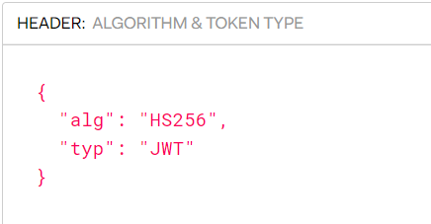
Tahaluf Copyright 2022- All Right Reserved
Harmony IT Solution
Header
The type of the token, which is JWT, and the signature algorithm being used, such as HMAC SHA256 or RSA, are both typically component included in the header.

Slide 13
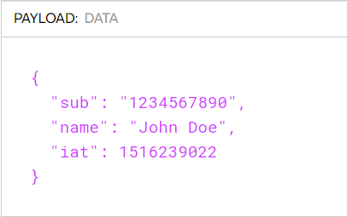
Tahaluf Copyright 2022- All Right Reserved
Harmony IT Solution
Payload
The payload is the second part of the token, which contains the claims. Claims are statements about a subject (usually the user) and additional information.

Slide 14
Tahaluf Copyright 2022- All Right Reserved
Harmony IT Solution
Signature
The encoded payload, encoded header, a secret, and the algorithm mentioned in the header must all be combined to generate the signature portion.
When a token is signed with a private key, it may also confirm that the sender of the JWT is who they claim to be. The signature is used to ensure that the message wasn't altered along the way.

Slide 15
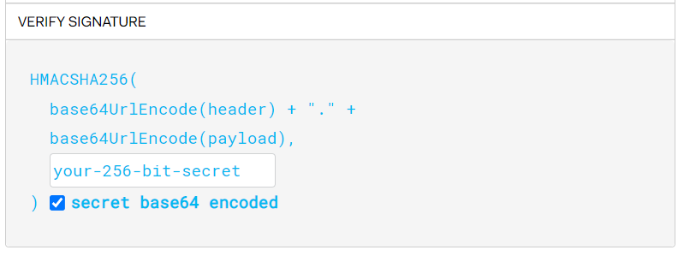
Tahaluf Copyright 2022- All Right Reserved
Harmony IT Solution

Slide 16
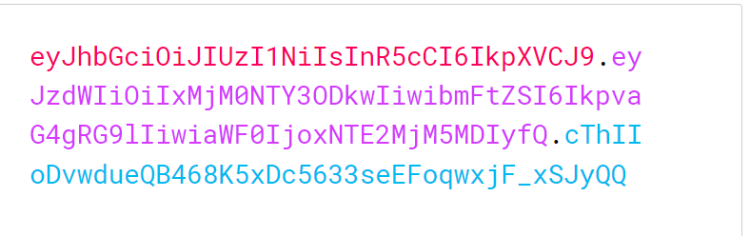
Tahaluf Copyright 2022- All Right Reserved
Harmony IT Solution
JWT

Slide 17
Tahaluf Copyright 2022- All Right Reserved
Harmony IT Solution
How do JSON Web
Tokens work

Slide 18
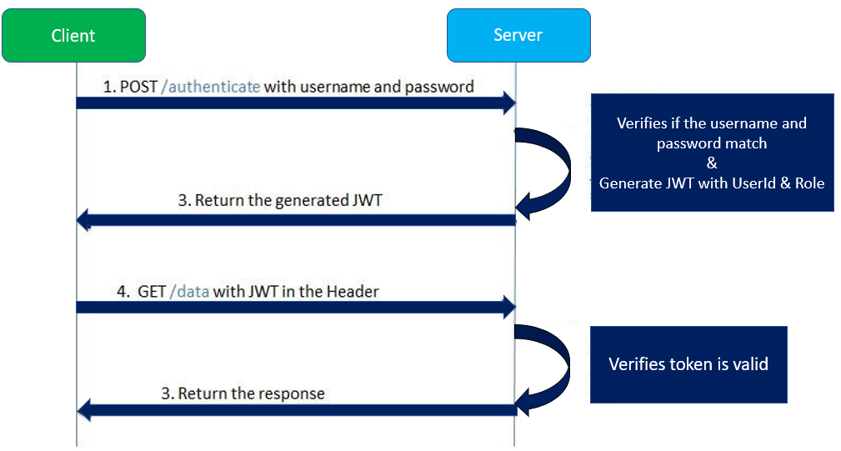
Tahaluf Copyright 2022- All Right Reserved
Harmony IT Solution

Slide 19
Tahaluf Copyright 2022- All Right Reserved
Harmony IT Solution
Create LOGIN using JWT Token

Slide 20
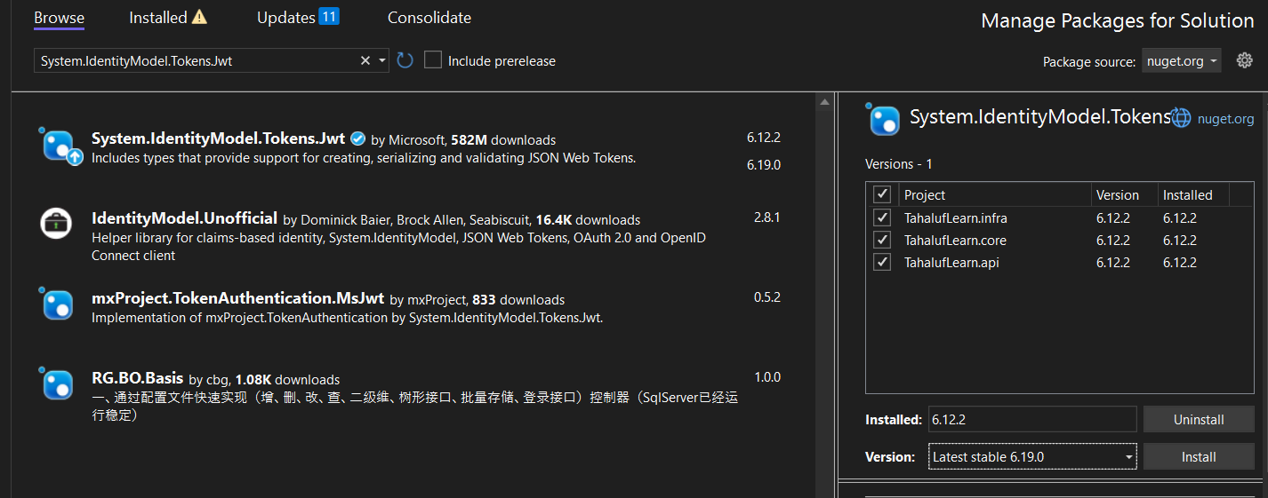
Tahaluf Copyright 2022- All Right Reserved
Harmony IT Solution
Tools => NuGet Package Manager => Manage NuGet Packages for Solution => System.IdentityModel.Tokens.Jwt

Slide 21
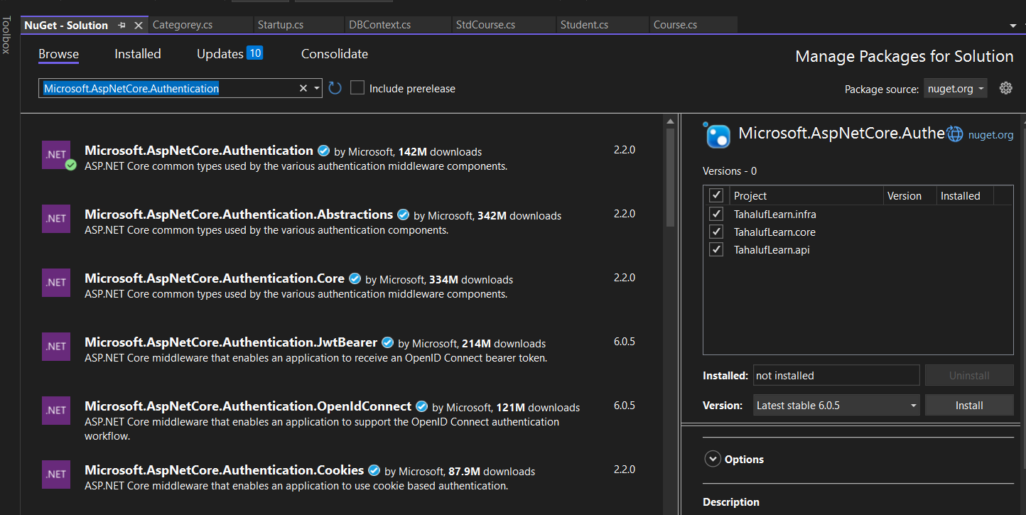
Tahaluf Copyright 2022- All Right Reserved
Harmony IT Solution
Tools => NuGet Package Manager => Manage NuGet Packages for Solution => Microsoft.AspNetCore.Authentication.JwtBearer

Slide 22
Tahaluf Copyright 2022- All Right Reserved
Harmony IT Solution
Create Login package on SQL developer :
create or replace PACKAGE Login_Package
AS
PROCEDURE User_Login(User_NAME IN VARCHAR,PASS IN VARCHAR);
END Login_Package;

Slide 23
Tahaluf Copyright 2022- All Right Reserved
Harmony IT Solution
create or replace PACKAGE body Login_Package
AS
PROCEDURE User_Login(User_NAME IN VARCHAR,PASS IN VARCHAR)
AS
c_all SYS_REFCURSOR;
BEGIN
open c_all for
SELECT USERNAME,roleid FROM LOGIN WHERE USERNAME=User_NAME
AND PASSWORD=PASS;
DBMS_SQL.RETURN_RESULT(c_all);
end User_Login;
END Login_Package;

Slide 24
Tahaluf Copyright 2022- All Right Reserved
Harmony IT Solution
Startup => ConfigureServices => Add the following:
services.AddAuthentication(opt => {
opt.DefaultAuthenticateScheme = JwtBearerDefaults.AuthenticationScheme;
opt.DefaultChallengeScheme = JwtBearerDefaults.AuthenticationScheme;
})
.AddJwtBearer(options =>
{

Slide 25
Tahaluf Copyright 2022- All Right Reserved
Harmony IT Solution
options.TokenValidationParameters = new TokenValidationParameters
{
ValidateIssuer = true,
ValidateAudience = true,
ValidateLifetime = true,
ValidateIssuerSigningKey = true,
IssuerSigningKey = new SymmetricSecurityKey(Encoding.UTF8.GetBytes("superSecretKey@345"))
};
});

Slide 26
Tahaluf Copyright 2022- All Right Reserved
Harmony IT Solution
Startup => Configure => Add the following:
app.UseAuthentication();

Slide 27
Tahaluf Copyright 2022- All Right Reserved
Harmony IT Solution
TahalufLearn.core => Repository => Create IJWTRepository.cs
public interface IJWTRepository
{
Login Auth(Login login);
}
Notes:
using Microsoft.AspNetCore.Mvc;
using System.Net.Http;
using System.Threading.Tasks;
using Newtonsoft.Json;
using System;
using TahalufLearn.core.DTO;
namespace TahalufLearn.api.Controllers
{
[Route("api/[controller]")]
[ApiController]
public class WeatherController : ControllerBase
{
[HttpGet("weather/{city}")]
public async Task<IActionResult> City(string city)
{
using (var client = new HttpClient())
{
try
{
client.BaseAddress = new Uri("http://api.openweathermap.org");
var response = await client.GetAsync($"/data/2.5/weather?q={city}&appid=511ba00e6b1fdebcf7456541e7a16390");
response.EnsureSuccessStatusCode();
var stringResult = await response.Content.ReadAsStringAsync();
var weatherResult = JsonConvert.DeserializeObject<Weather>(stringResult);
return Ok(new
{
Temp = weatherResult.main.Temp,
City = weatherResult.name,
speed = weatherResult.wind.speed,
humidity = weatherResult.main.humidity
});
}
catch (HttpRequestException httpRequestException)
{
return BadRequest($"Error getting weather from OpenWeather: {httpRequestException.Message}");
}
}
}
}
}

Slide 28
Tahaluf Copyright 2022- All Right Reserved
Harmony IT Solution
TahalufLearn.core => Service => Create IJWTService.cs
public interface IJWTService
{
string Auth(Login login);
}
Notes:
using Microsoft.AspNetCore.Mvc;
using System.Net.Http;
using System.Threading.Tasks;
using Newtonsoft.Json;
using System;
using TahalufLearn.core.DTO;
namespace TahalufLearn.api.Controllers
{
[Route("api/[controller]")]
[ApiController]
public class WeatherController : ControllerBase
{
[HttpGet("weather/{city}")]
public async Task<IActionResult> City(string city)
{
using (var client = new HttpClient())
{
try
{
client.BaseAddress = new Uri("http://api.openweathermap.org");
var response = await client.GetAsync($"/data/2.5/weather?q={city}&appid=511ba00e6b1fdebcf7456541e7a16390");
response.EnsureSuccessStatusCode();
var stringResult = await response.Content.ReadAsStringAsync();
var weatherResult = JsonConvert.DeserializeObject<Weather>(stringResult);
return Ok(new
{
Temp = weatherResult.main.Temp,
City = weatherResult.name,
speed = weatherResult.wind.speed,
humidity = weatherResult.main.humidity
});
}
catch (HttpRequestException httpRequestException)
{
return BadRequest($"Error getting weather from OpenWeather: {httpRequestException.Message}");
}
}
}
}
}

Slide 29
Tahaluf Copyright 2022- All Right Reserved
Harmony IT Solution
TahalufLearn.Infra => Repositry => Create JWTRepository.cs
public class JWTRepository : IJWTRepository
{
private readonly IDBContext dBContext;
public JWTRepository(IDBContext dBContext)
{
this.dBContext = dBContext;
}

Slide 30
Tahaluf Copyright 2022- All Right Reserved
Harmony IT Solution
public Login Auth(Login login)
{
var p = new DynamicParameters();
p.Add("User_NAME", login.Username, dbType: DbType.String, direction: ParameterDirection.Input);
p.Add("PASS", login.Password, dbType: DbType.String, direction: ParameterDirection.Input);
IEnumerable<Login> result = dBContext.Connection.Query<Login>("Login_Package.User_Login", p, commandType: CommandType.StoredProcedure);
return result.FirstOrDefault();
}

Slide 31
Tahaluf Copyright 2022- All Right Reserved
Harmony IT Solution
TahalufLearn.Infra => Service => Create JWTService.cs
private readonly IJWTRepository reposiytory;
public JWTService(IJWTRepository reposiytory)
{
this.reposiytory = reposiytory;
}

Slide 32
Tahaluf Copyright 2022- All Right Reserved
Harmony IT Solution
public string Auth(Login login)
{
var result = reposiytory.Auth(login);
if (result == null)
{
return null;
}
else
{
var secretKey = new SymmetricSecurityKey(Encoding.UTF8.GetBytes("superSecretKey@345"));
var signinCredentials = new SigningCredentials(secretKey, SecurityAlgorithms.HmacSha256);
var claims = new List<Claim>

Slide 33
Tahaluf Copyright 2022- All Right Reserved
Harmony IT Solution
{
new Claim(ClaimTypes.Name, result.Username),
new Claim(ClaimTypes.Role, result.Roleid.ToString())
};
var tokeOptions = new JwtSecurityToken(
claims: claims,
expires: DateTime.Now.AddSeconds(10),
signingCredentials: signinCredentials
);
var tokenString = new JwtSecurityTokenHandler().WriteToken(tokeOptions);
return tokenString;
}

Slide 34
Tahaluf Copyright 2022- All Right Reserved
Harmony IT Solution
In Startup:
services.AddScoped<IJWTRepository, JWTRepository>();
services.AddScoped<IJWTService, JWTService>();

Slide 35
Tahaluf Copyright 2022- All Right Reserved
Harmony IT Solution
TahalufLearn.API => Controller => Create JWTController.cs
private readonly IJWTService jwtservice;
public JWTController(IJWTService jwtservice)
{
this.jwtservice = jwtservice;
}

Slide 36
Tahaluf Copyright 2022- All Right Reserved
Harmony IT Solution
[HttpPost]
public IActionResult Auth([FromBody] Login login)
{
var token = jwtservice.Auth(login);
if (token == null)
{
return Unauthorized();
}
else
{
return Ok(token);
}
}

